Slide 1



LightGuardian: A Full-Visibility, Lightweight, In-band Telemetry System Using Sketchlets
Yikai Zhao, Kaicheng Yang, Zirui Liu, Tong Yang, Li Chen, Shiyi Liu, Naiqian Zheng, Ruixin Wang, Hanbo Wu, Yi Wang, Nicholas Zhang

Slide 2


Background
measurement is central to successful network operations

Slide 3

Background
Packet lost
What’s wrong

Slide 4
Background
High latency
What’s wrong

Slide 5
Background
measurement is central to successful network operations
full-visibility
per-hop flow-level information for all flows
lightweight
computation, memory, bandwidth
robustness
link failures, device failures

Slide 6
Background
existing solution
sampling
probing
sketch-based
in-band
(currently) lack of full-visibility
(currently) lack of lightweight

Slide 7
LightGuardian Overview
Accurate & versatile device-local sketches
In-band telemetry with sketchlets
Incremental network-wide aggregation

Slide 8
LightGuardian Overview
Accurate & versatile device-local sketches

Slide 9
LightGuardian Overview
In-band telemetry with sketchlets
sketch
sketchlets

Slide 10
LightGuardian Overview
Incremental network-wide aggregation

Slide 11

LightGuardian Overview
Incremental network-wide aggregation
switch 0
switch 1
switch 8
switch 9

Slide 12
Device-local Sketch Design: SuMax
record both of the sum value and the maximum value
record both of the sum value and the maximum value
record both of the sum value and the maximum value
record both of the sum value and the maximum value
sum cell
SuMax Sketch
SuMax Sketch
SuMax Sketch
SuMax Sketch
max cell

Slide 13


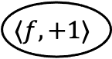
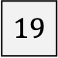

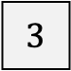

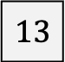


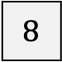


Device-local Sketch Design: SuMax
record both of the sum value and the maximum value
$$8$$
$$8++$$
$$9$$
$$13$$
$$13++$$
$$⟨f,+1⟩$$
$$14$$
$$3$$
$$3++$$
$$4$$
$$19$$
$$19++$$
$$20$$
sum cell
SuMax Sketch

Slide 14
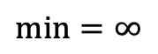

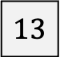

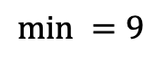


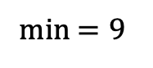

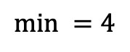
Device-local Sketch Design: SuMax
approximate conservative update strategy
$$8$$
$$min=∞$$
$$8++$$
$$9$$
$$13$$
min $=9$
$$13→13$$
$$⟨f,+1⟩$$
$$3$$
$$min =9$$
$$3++$$
$$4$$
$$19$$
$$min =4$$
$$19→19$$
sum cell
SuMax Sketch

Slide 15
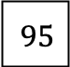
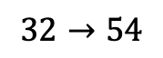
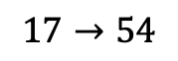

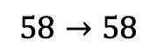
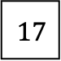
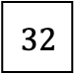
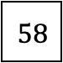
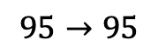

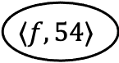
Device-local Sketch Design: SuMax
record both of the sum value and the maximum value
$$32$$
$$32→54$$
$$54$$
$$⟨f,54⟩$$
$$95$$
$$95→95$$
$$58$$
$$58→58$$
$$17$$
$$17→54$$
$$54$$
SuMax Sketch
max cell

Slide 16
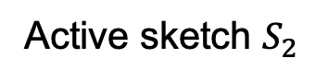
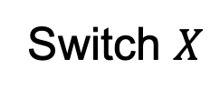
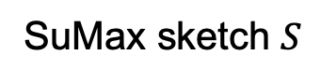
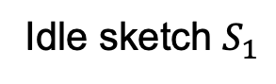
Transmission of Sketchlets
Idle sketch $S_{1}$
SuMax sketch $S$
Active sketch $S_{2}$
Switch $X$

Slide 17
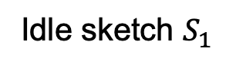
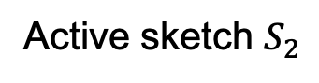
Transmission of Sketchlets
packet
Idle sketch $S_{1}$
Active sketch $S_{2}$
Transport Layer
TCP Header
Application Layer
TCP Header
Application Layer
carry-bit
device ID
sketchlet ID
active-bit
sketchlet
Switch $X$

Slide 18
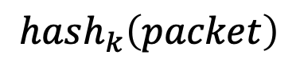
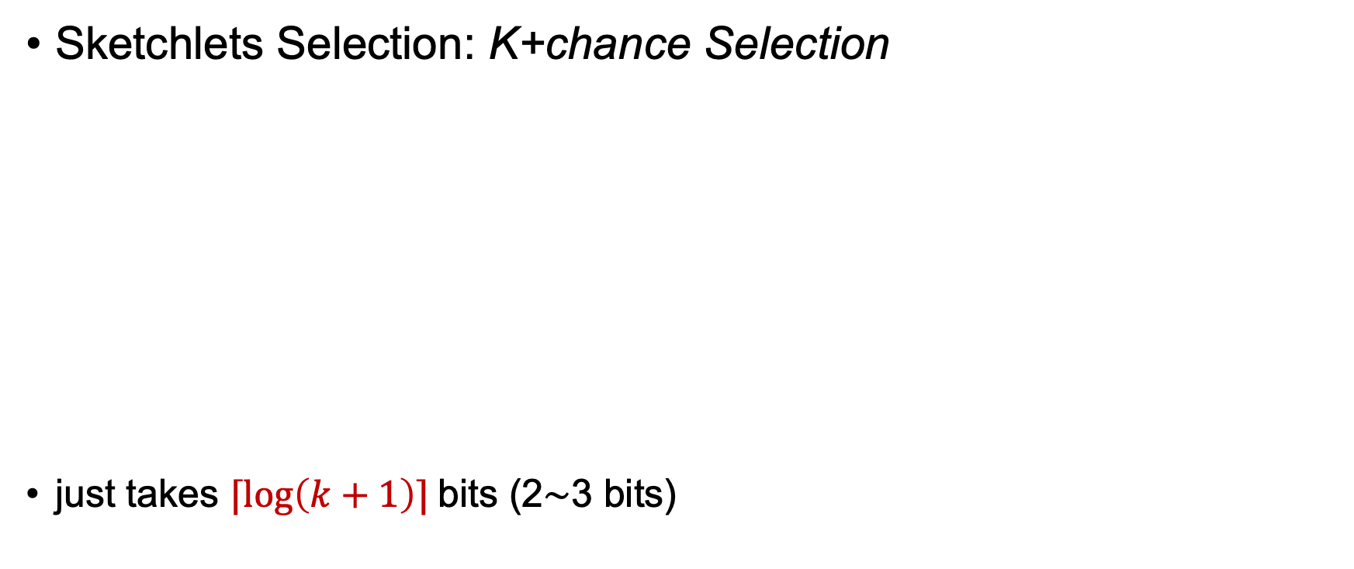
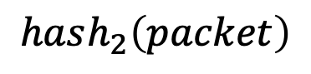
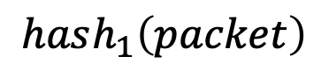
Transmission of Sketchlets
Sketchlets Selection: K+chance Selection
just takes $⌈\log\left(k+1\right)⌉$bits (2∼3 bits)
$$hash_{1}\left(packet\right)$$
$$0$$ | $$0$$ | $$0$$ | $$1$$ | $$0$$ | $$0$$ | $$0$$ | $$1$$ | $$1$$ | $$1$$ | $$1$$ | $$1$$ | $$1$$ | $$1$$ | $$0$$ | $$1$$
$$hash_{2}\left(packet\right)$$
$$1$$ | $$0$$ | $$1$$ | $$0$$ | $$1$$ | $$0$$ | $$0$$ | $$0$$ | $$0$$ | $$0$$ | $$1$$ | $$0$$ | $$1$$ | $$0$$ | $$0$$ | $$0$$
…
$$hash_{k}\left(packet\right)$$

Slide 19


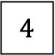
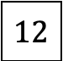

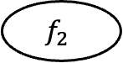
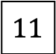
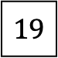
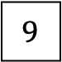

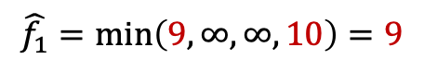
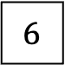
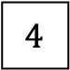
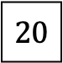
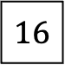
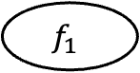
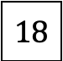

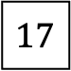
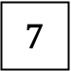

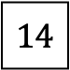
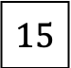
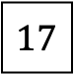

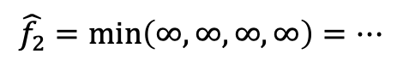
Reconstruction and Analysis
Incremental reconstruction
$$f_{1}$$
$$\hat{f_{1}}=\min\left(9,∞,∞,10\right)=9$$
$$6$$
$$9$$
$$4$$
$$4$$
$$4$$
$$4$$
$$14$$
$$14$$
valid
$$1$$
$$12$$
$$11$$
$$15$$
$$15$$
$$15$$
$$18$$
$$18$$
$$f_{2}$$
$$\hat{f_{2}}=\min\left(∞,∞,∞,∞\right)=…$$
$$11$$
$$17$$
$$5$$
$$7$$
$$7$$
$$7$$
$$20$$
$$20$$
invalid
$$1$$
$$10$$
$$17$$
$$16$$
$$16$$
$$16$$
$$19$$
$$19$$

Slide 20
Reconstruction and Analysis
Locating Inﬂated Latency
Locating Packet Drops
Blackhole
Loop
Random packet drops
Locating Abnormal Jitters
Finding Abnormal Forwarding Path

Slide 21
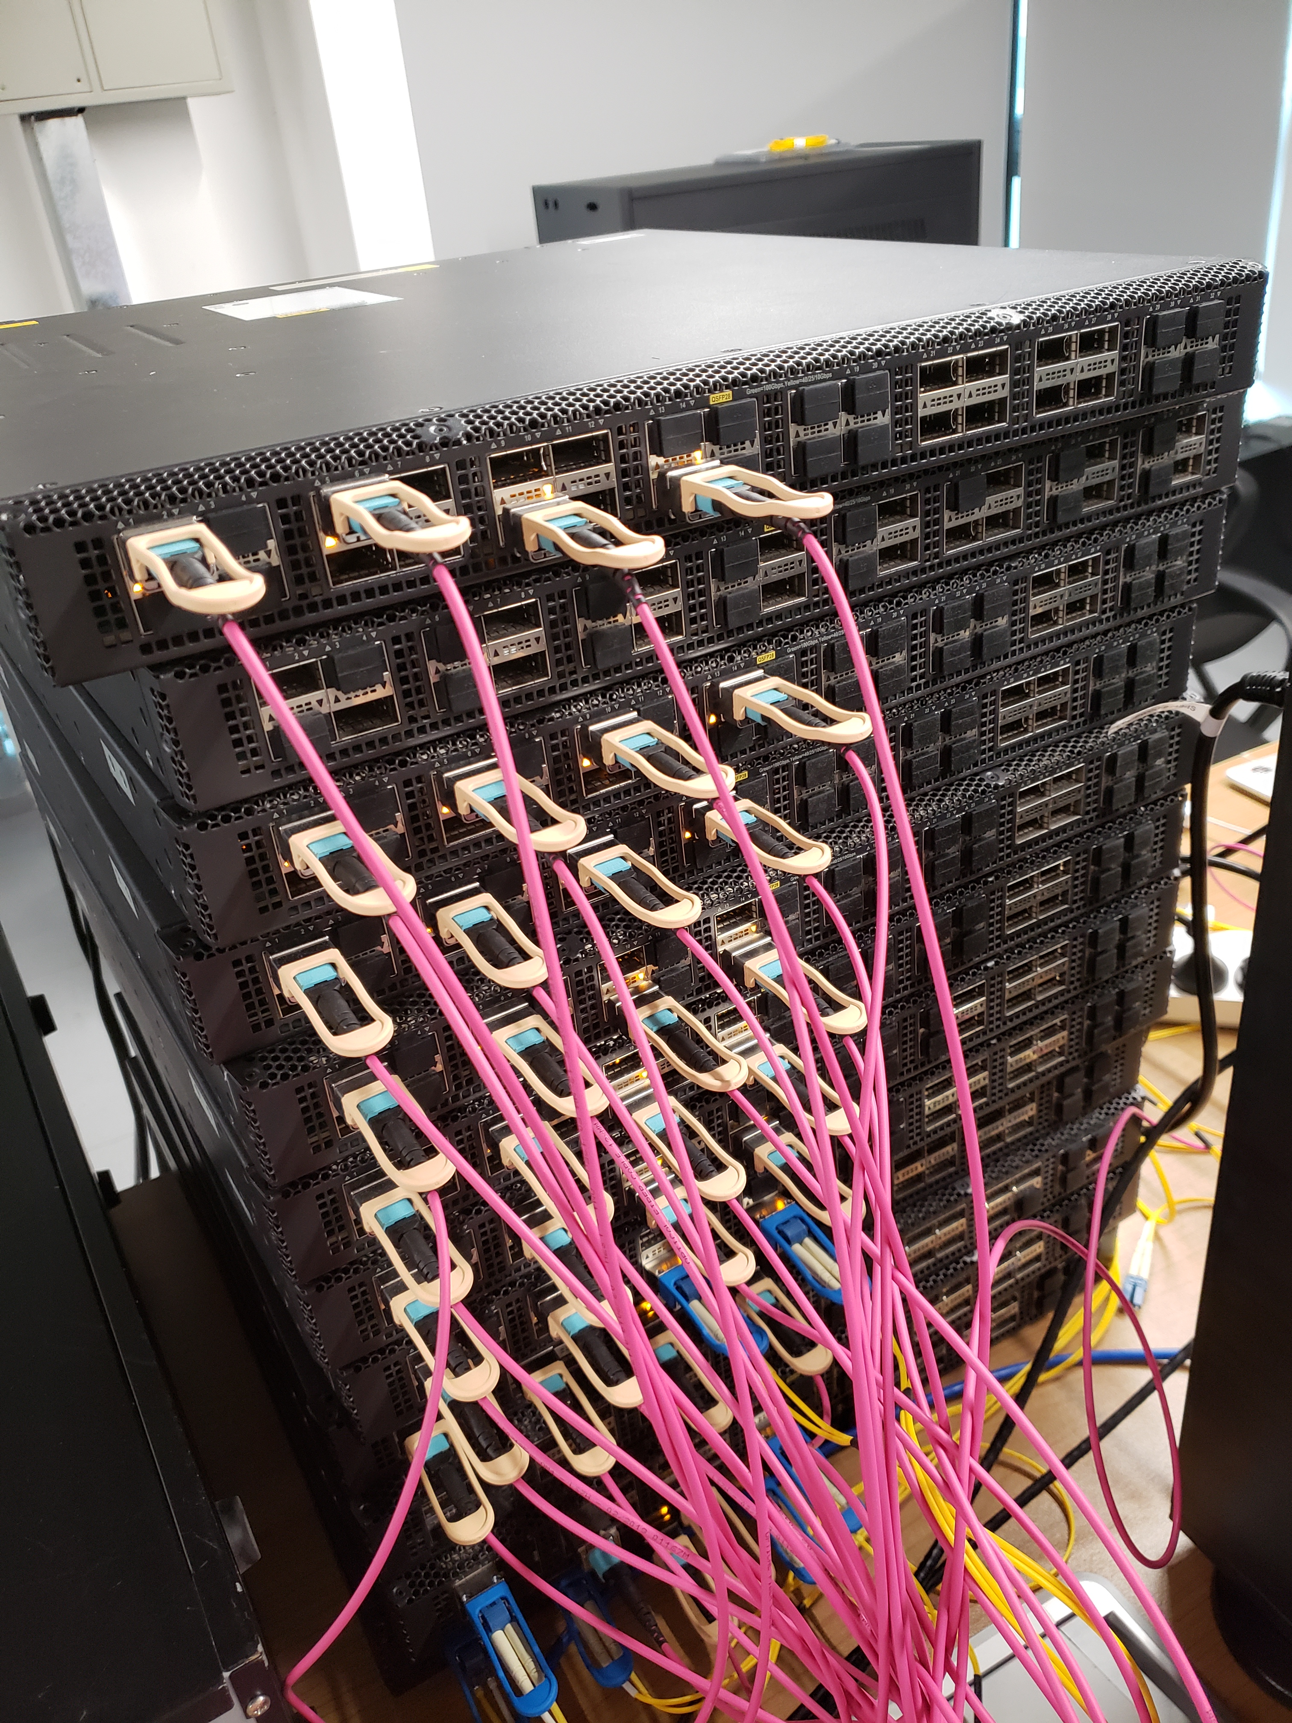
Experimental Results
Testbed
Toﬁno-40GbE

Slide 22
Experimental Results
How accurate can our SuMax sketch measure per-ﬂow statistics?
Flow size estimation
Cardinality estimation
Entropy estimation
Delay distribution
Maximum inter-arrival time

Slide 23
Experimental Results
How accurate can LightGuardian detect network anomalies?
Locating blackholes
Locating loops
Locating abnormal jitters

Slide 24
Experimental Results
How much is the overhead of sending and aggregating sketchlets?
FCT
Per-hop latency
Bandwidth overhead

Slide 25
Experimental Results
Is LightGuardian resilient to network failures?
Full-Recovery Rate (FRR):
the probability of recovering all sketches
Recovering-Sketch Rate (RSR):
the ratio of the number of recovered sketches to the number of all sketches

Slide 26
LightGuardian
full-visibility: deploy SuMax sketch, monitor various per-ﬂow per-hop information for all flows
Lightweight: use only 0.07% total bandwidth capacity
Robustness: incremental reconstruction

Slide 27
LightGuardian
Thank you!
Our code is open-source!
https://github.com/Light-Guardian/LightGuardian

